Slide 1
Prototype Asset Survey App Assignment
Chris Rakowski demo presentation
2nd September

Slide 2
Introduction
Christopher Rakowski, Chemistry Graduate, Aspiring Developer
Applying for the opportunity to join the development team at EAMs

Slide 3
Project Outline
Project requirements
User login/authentication.
Data storage searchable by Asset ID
Create, Read, Update and Delete permissions
Client-side storage that synchronises with online backend
Seamless online-offline (with status indicator)
App specifications
Asset ID – a unique identifier up to 15 characters
Condition – select from a value list
Status – select from a value list
Created Date – set automatically when asset created
Changed Date – set automatically when assed saved
Changed By – set automatically as user ID

Slide 4




What I chose to use
Why NativeScript?
Why Angular/Typescript?
Why GitHub?
Why Firebase?
?

Slide 5
Problems Encountered
Multidex support
Firebase authentication
Firebase firestore
Had to start the project over several times (going down the wrong path)
Integrating my own code with NativeScript code samples
Unhelpful and occasionally incorrect documentation
Long lead times on getting advice from online community (through stack overflow, slack, gitHub etc)

Slide 6
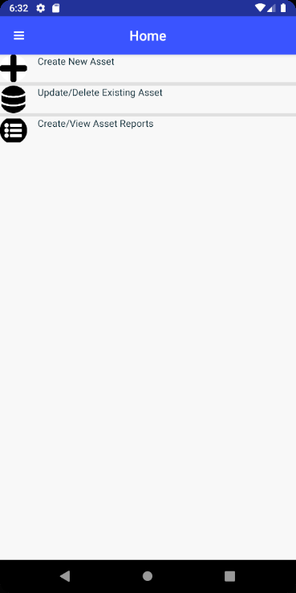
Project Milestones
Design the app UI
Research JavaScript frameworks
Research app development software and methods
Research backend services
Build app UI (Build Login Screen, Home Page, Create New Asset Page UI)
Got Login Screen to Function, connect to firebase backend
Add backend functionality to UI frontend

Slide 7
Demo Time

Slide 8
Development Time

Slide 10
Learning Resources Used
To learn how to build this app I used the following resources
www.stackoverflow.com
https://docs.nativescript.org/.
https://firebase.google.com/docs?authuser=0
Documentation from https://github.com/EddyVerbruggen/nativescript-plugin-firebase/tree/master/docs for the firebase functions
The NativeScript community on Slack
Friends and family
Several book shelves worth of reading material.

Slide 11
Thank you all for your time and patience Questions and feedback are gratefully welcomed.

